Slide 1
Media & Advertisement

Slide 2
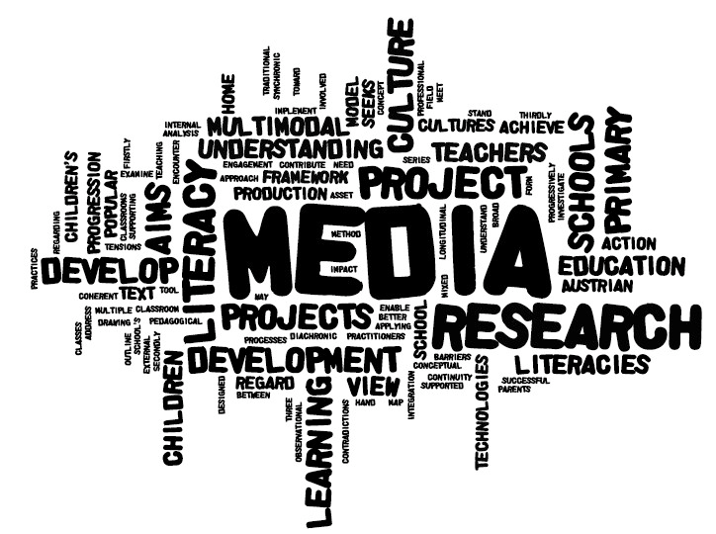
What is Media?
https://www.youtube.com/watch?v=bBP_kswrtrw

Slide 3
“I don’t know who discovered water, but I’m pretty sure it wasn’t a fish”

Slide 4
How does this quote relate to media?
This is an expression that can be used to describe the role and way of media in our everyday human lives. We are constantly surrounded by media, we may not even notice that we are consuming it – or more, importantly, we may consume it without paying attention or engaging with it critically. Unlike fish, though, people can learn to pay attention and engage with the “sea” or media around us.
In this case: Humans are to media as a fish is to water.

Slide 5
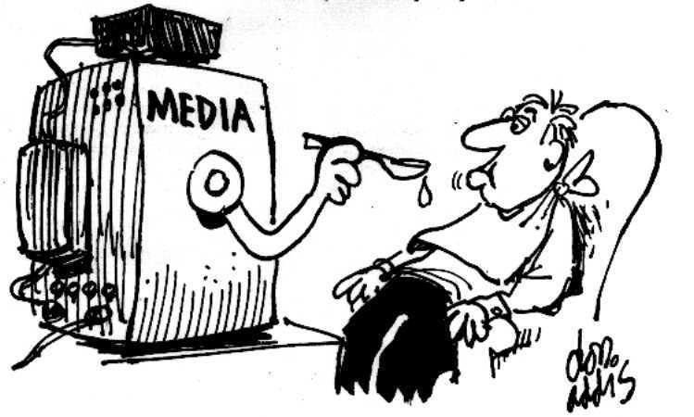
Media Audit
Take about 5 minutes to fill in the list of a “typical day in the life of YOU”. How much time do you think you spend on various different forms of media?

Slide 6
The 5 Concepts of Media

Slide 7
1. Media are Constructions
Media products are created by individuals who make conscious and unconscious choices about what to include, what to leave out and how to present what is included
These decisions are based on the creators own point of view
As a result of this, media products are never entirely accurate reflections of the real world
ASK YOURSELF:
Who created this media product?
What is its purpose?
What assumptions or beliefs do its creators have that are reflected in the content?
https://www.youtube.com/watch?v=baftkjc5gKs&index=12&list=UU_jQ4vYf-WPf4_5eSdGABWQ

Slide 8
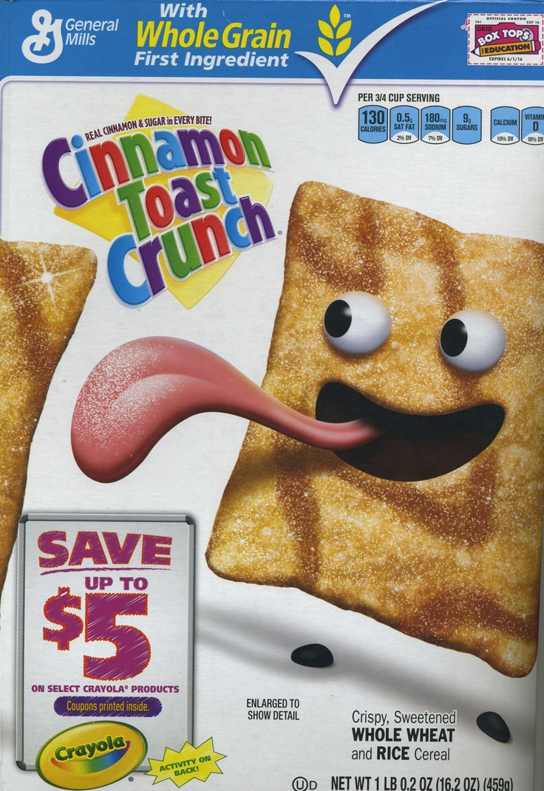
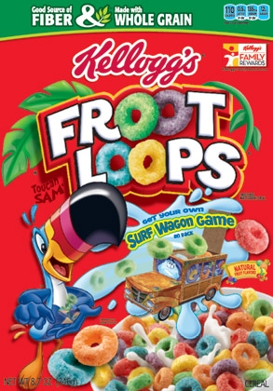
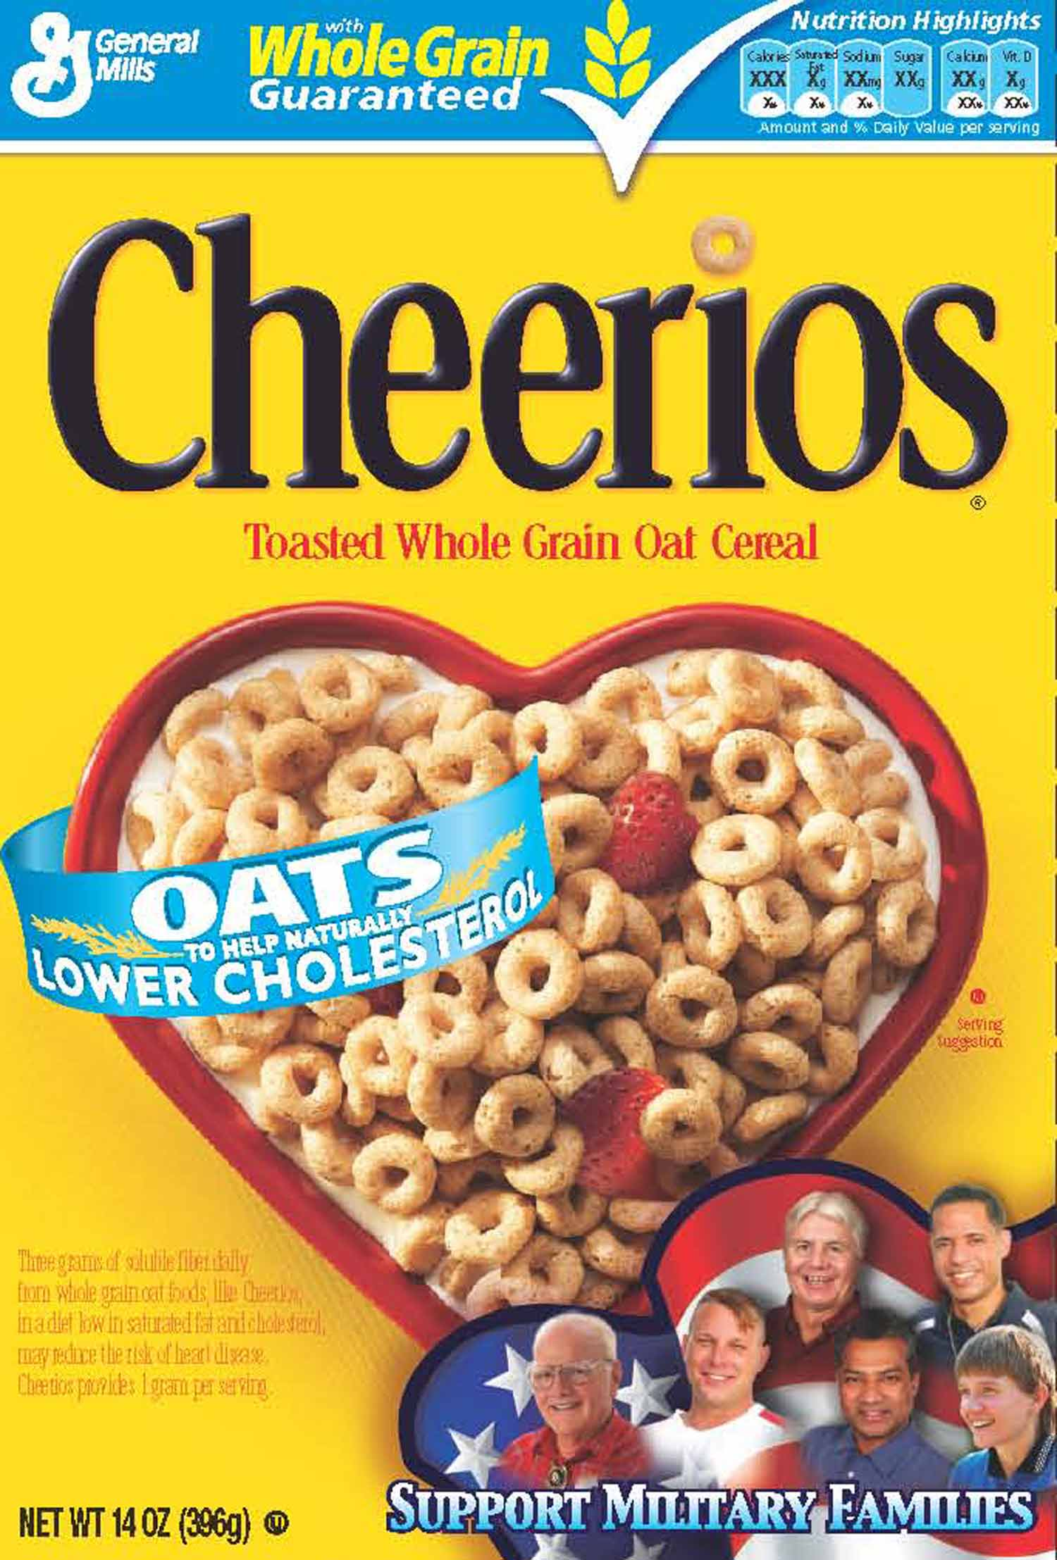
What choices were made in the creation of this cereal box and what is the intended audience.

Slide 9
2. Audiences Negotiate Meaning
The meaning of any media product is not created solely by its producers but is, instead, a collaboration between them and the audience – which means that different audiences can take away different meanings from the same product.
ASK YOURSELF:
How might different people see this media product differently?
How does this make you feel, based on how similar or different you are from the people portrayed in the media product?
https://www.youtube.com/watch?v=goyXz1VmhWA&index=8&list=UU_jQ4vYf-WPf4_5eSdGABWQ

Slide 10
3. Media have Commercial Implications
Most media production is a business and must, therefore, make a profit.
Questions of ownership and control are central – a relatively small number of individuals control what we watch, read and hear in the media.
ASK YOURSELF
What is the commercial purpose of this media product (in other words, how will it help someone make money)?
How does this influence the content and how it’s communicated?
If no commercial purpose can be found, what other purposes might the media product have (for instance, to get attention for its creator or to convince audiences of a particular point of view)
https://www.youtube.com/watch?v=RdkH0GwJy6A&list=UU_jQ4vYf-WPf4_5eSdGABWQ&index=11

Slide 11
4. Media have Social and Political Implications
Media convey ideological messages about values, power and authority. In media literacy, what or who is absent may be more important than what or who is included. These messages may be the result of conscious decisions, but more often they are the result of unconscious biases and unquestioned assumptions – and they can have a significant influence on what we think and believe.
ASK YOURSELF
Who and what is shown in a positive light? In a negative light?
Why might these people and things be shown this way?
Who and what is not shown at all?
What conclusions might audiences draw based on these facts?
https://www.youtube.com/watch?v=YZi6s22yktw&index=10&list=UU_jQ4vYf-WPf4_5eSdGABWQ

Slide 12
5. Each Medium has Unique Aesthetic Form
The content of media depends in part on the nature of the medium. This includes the technical, commercial and storytelling demands of each medium: for instance, the interactive nature of video games leads to different forms of storytelling – and different demands on media creators – that are found in film and TV.
ASK YOURSELF:
What techniques does the media product use to get your attention and to communicate its message?
In what ways are the images in the media product manipulated through various techniques (for example: lighting, makeup, camera angle, photo manipulation)?
What are the expectations of the genre (for example: print advertising, TV drama, music video) towards its subject?
https://www.youtube.com/watch?v=d76X-uCy7No&list=UU_jQ4vYf-WPf4_5eSdGABWQ&index=9

Slide 15
Get a Load of Milk
https://www.youtube.com/watch?v=SIbwqf-cLOU&index=4&list=PLLGtfhUlzJ5-glV6nT62JYPyJ1crF5LaE
What is the purpose of these media products?
What message is being conveyed?
How is the message communicated?
What do the ads in the different media have in common?
What tools are available in one medium but not the other?
Which ad do you think is most effective for the purpose of this ad and why?

